Slide 1

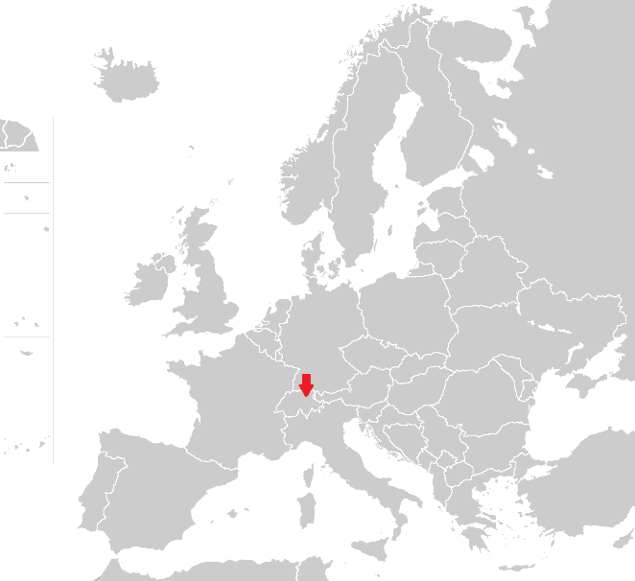
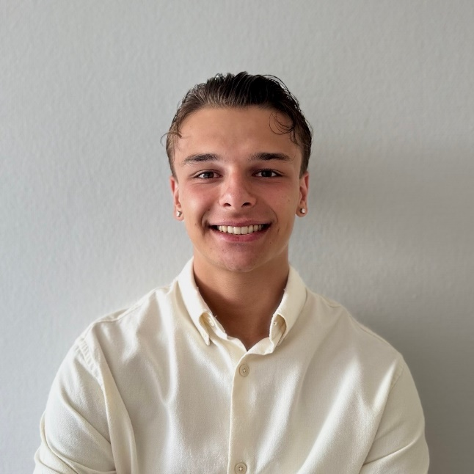



Stevan Kovačević
University: OST - Eastern Switzerland University
of Applied Sciences
Study program: Business Informatics
Year of study: 3rd
City: Zürich, Switzerland
Motto for life: everything passes.
Hobbies: Hiking, Cycling, Working Out
Your expectations from the summer school:
Learn more about sustainability and make new international friends.
Location where I live and work
Karlsruhe
31 August to 11 September 2026

